Slide 1


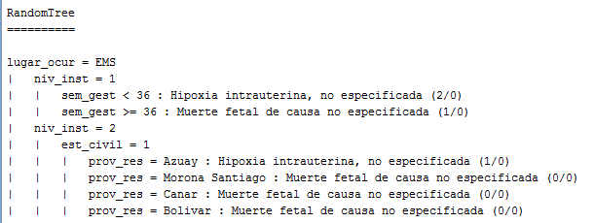
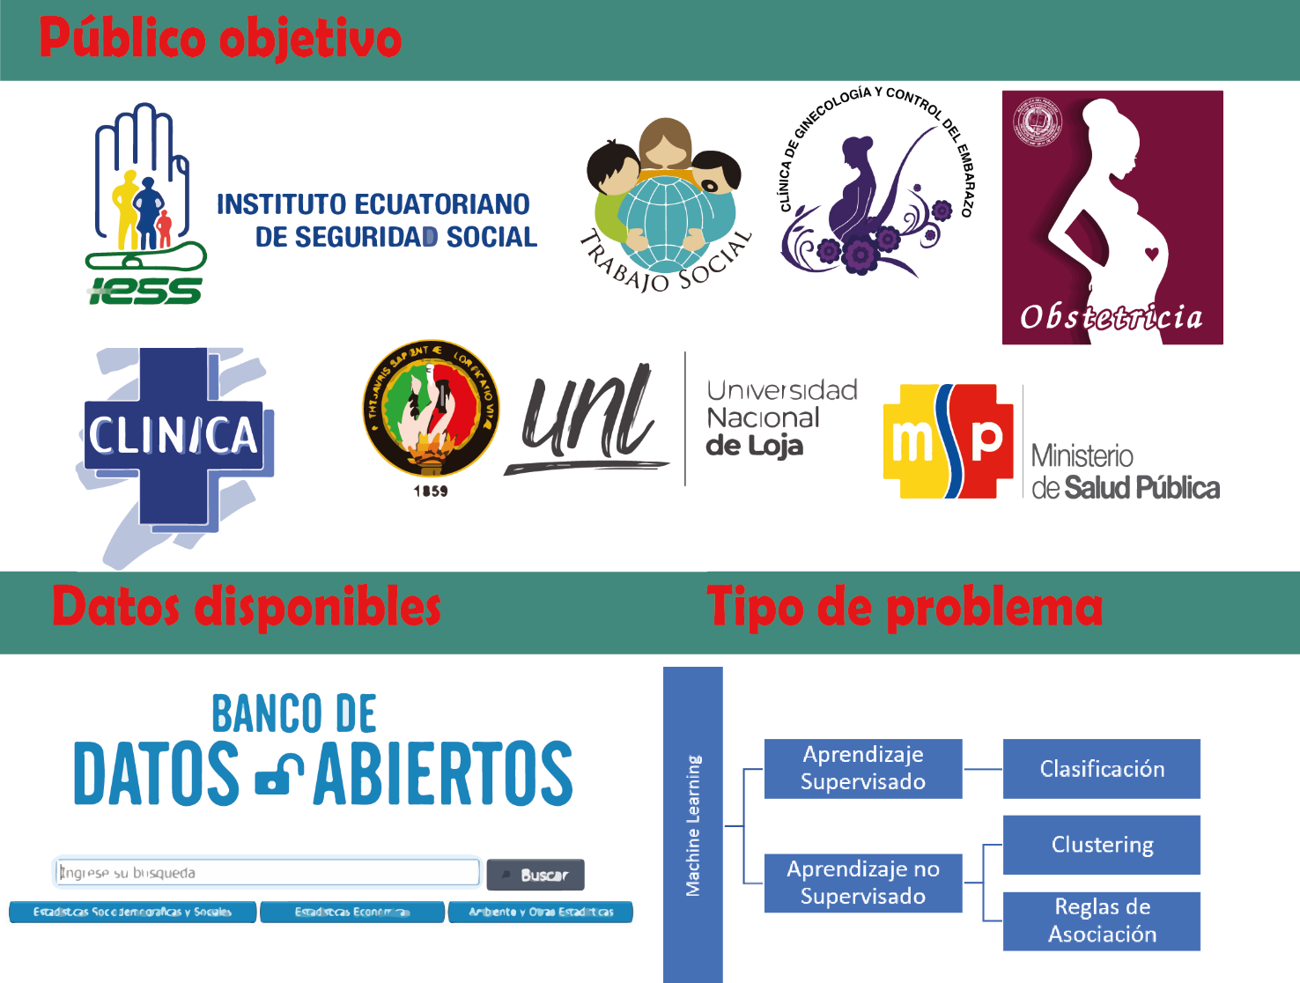
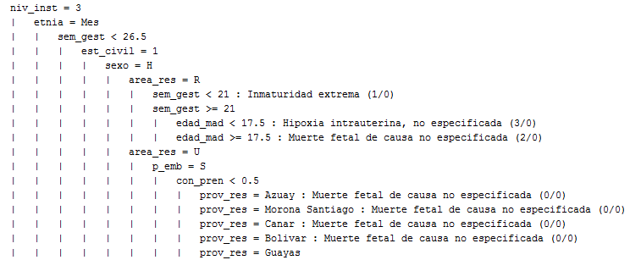
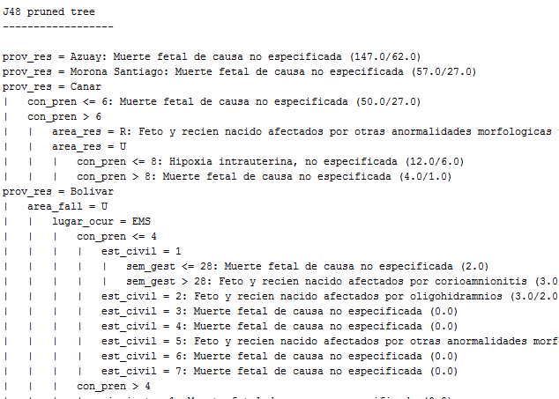
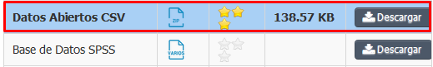


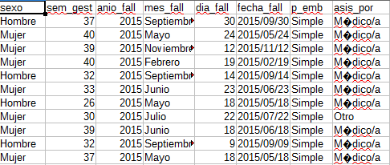



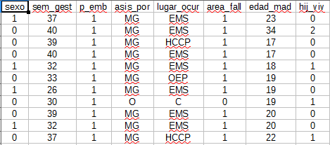
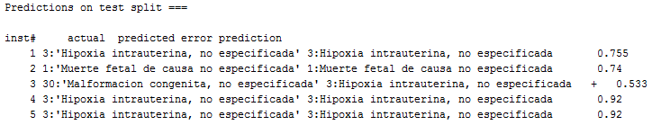
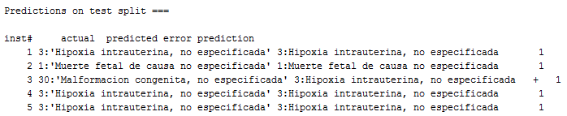

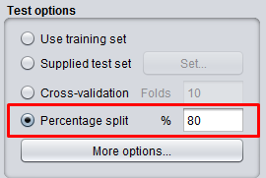
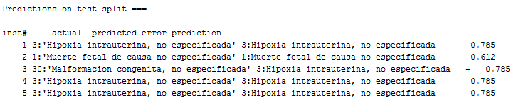
Supervised and unsupervised machine learning: case study "fetal deaths" using the open database of the "INEC - Ecuador".
Facultad de Energía, Carrera de Ingeniería en Sistemas
Steeven Armijos-Bravo
Abstract
In the present project 3 supervised classification algorithms were applied: RandomTree, RandomForest, J48, in order to predict the type of disease causing fetal deaths by the year 2020, unsupervised learning algorithms were also applied: Clustering (SimpleKMeans) to group according to certain characteristics what type of disease is most likely to cause fetal deaths, and Rules of Association (Apriori) to obtain rules based on the data set to aid decision making, in medical diagnostics, for example. This involved a process of problem definition, data collection (obtained from the INEC Open Data Bank, downloading .csv files for years 2015-2018), data preparation (removing check marks, special characters, outliers), data division (applying 80% for the training and 20% for the test), training (training the 3 classification algorithms mentioned above) and model validation (collecting the data in a table with the predictive accuracy of each classification algorithm). Translated with www.DeepL.com/Translator (free version)
1. Problem
5. Training a model
What kind of disease causes fetal deaths by 2020?
2. Data collection
http://aplicaciones3.ecuadorencifras.gob.ec/BIINEC-war/index.xhtml
Clustering: SimpleKMeans
Modelo | Características | Full Data (5298) | Clúster 0 (2845) | Clúster 1 (1098) | Clúster 2 (472) | Clúster 3 (883)
SimpleKMeans | sexo | H | H | M | M | H
 | p_emb | S | S | S | S | S
 | asis_por | MG | MG | MG | MG | MG
 | lugar_ocurr | EMS | EMS | EMS | EJB | EMS
 | area_fall | U | U | U | U | U
 | etnia | Mes | Mes | Mes | Mes | Mes
 | est_civil | 5 | 5 | 1 | 5 | 1
 | niv_inst | 12 | 12 | 12 | 12 | 13
 | prov_res | Guayas | Guayas | Guayas | Guayas | Pichincha
 | area_res | U | U | U | U | U
 | causa_fetal | Hipoxia intrauterina, no especificada | Hipoxia intrauterina, no especificada | Hipoxia intrauterina, no especificada | Hipoxia intrauterina, no especificada | Muerte fetal, no especificada
3. Data Preparation
Después
Reglas de Asociación: Apriori
Instancias: 5298
Atributos: 11
Instancias mínimas soportadas (2384)
Mejores reglas encontradas: 100
1. area_res=U causa_fetal=Hipoxia intrauterina, no especificada 2417 ==> area_fall=U 2405 <conf:(1)>
2. asis_por=MG causa_fetal=Hipoxia intrauterina, no especificada 2524 ==> area_fall=U 2503 <conf:(0.99)>
3. causa_fetal=Hipoxia intrauterina, no especificada 2648 ==> area_fall=U 2621 <conf:(0.99)>
4. sexo=H p_emb=S area_res=U 2411 ==> area_fall=U 2386 <conf:(0.99)>
5. sexo=H area_res=U 2578 ==> area_fall=U 2550 <conf:(0.99)>
6. p_emb=S etnia=Mes area_res=U 3863 ==> area_fall=U 3821 <conf:(0.99)>
7. p_emb=S asis_por=MG area_res=U 3940 ==> area_fall=U 3897 <conf:(0.99)>
8. p_emb=S causa_fetal=Hipoxia intrauterina, no especificada 2473 ==> area_fall=U 2446 <conf:(0.99)>
9. asis_por=MG area_res=U 4232 ==> area_fall=U 4185 <conf:(0.99)>
10. p_emb=S asis_por=MG etnia=Mes area_res=U 3596 ==> area_fall=U 3556 <conf:(0.99)>
Antes
6. Model validation
 | Instancias = 1060: 80% de entrenamiento y 20% test
 | RandomForest |  | RandomTree |  | J48
 | Correctos | Incorrectos | Correctos | Incorrectos | Correctos | Incorrectos
 | 563 | 497 | 461 | 599 | 539 | 521
Precisión | 53.11% | 46.89% | 43.49% | 56.51% | 50.85% | 49.15%
RandomForest
RandomTree
4. Data splitting
J48
Artificial Intelligence (2019-2020)
“Noveno ciclo”
smarmijosb@unl.edu.ec
https://github.com/ms96Armijos/Proyecto_IA

